Slide 1
Introduction to Databases Checkpoint
Abderrahman Dhahak

Slide 2
What is RDBMS
A relational database management system (RDBMS) is a common type of database that stores data in tables, so it can be used in relation to other stored datasets.
Most databases used by businesses these days are relational databases, as opposed to a flat file or hierarchical database. The majority of current IT systems and applications are based on a relational DBMS.
Using RDBMS allows us to:
No Data redundancy
Data Consistency and Integrity
Easy access to data
More flexibility than files
Recovery process

Slide 3
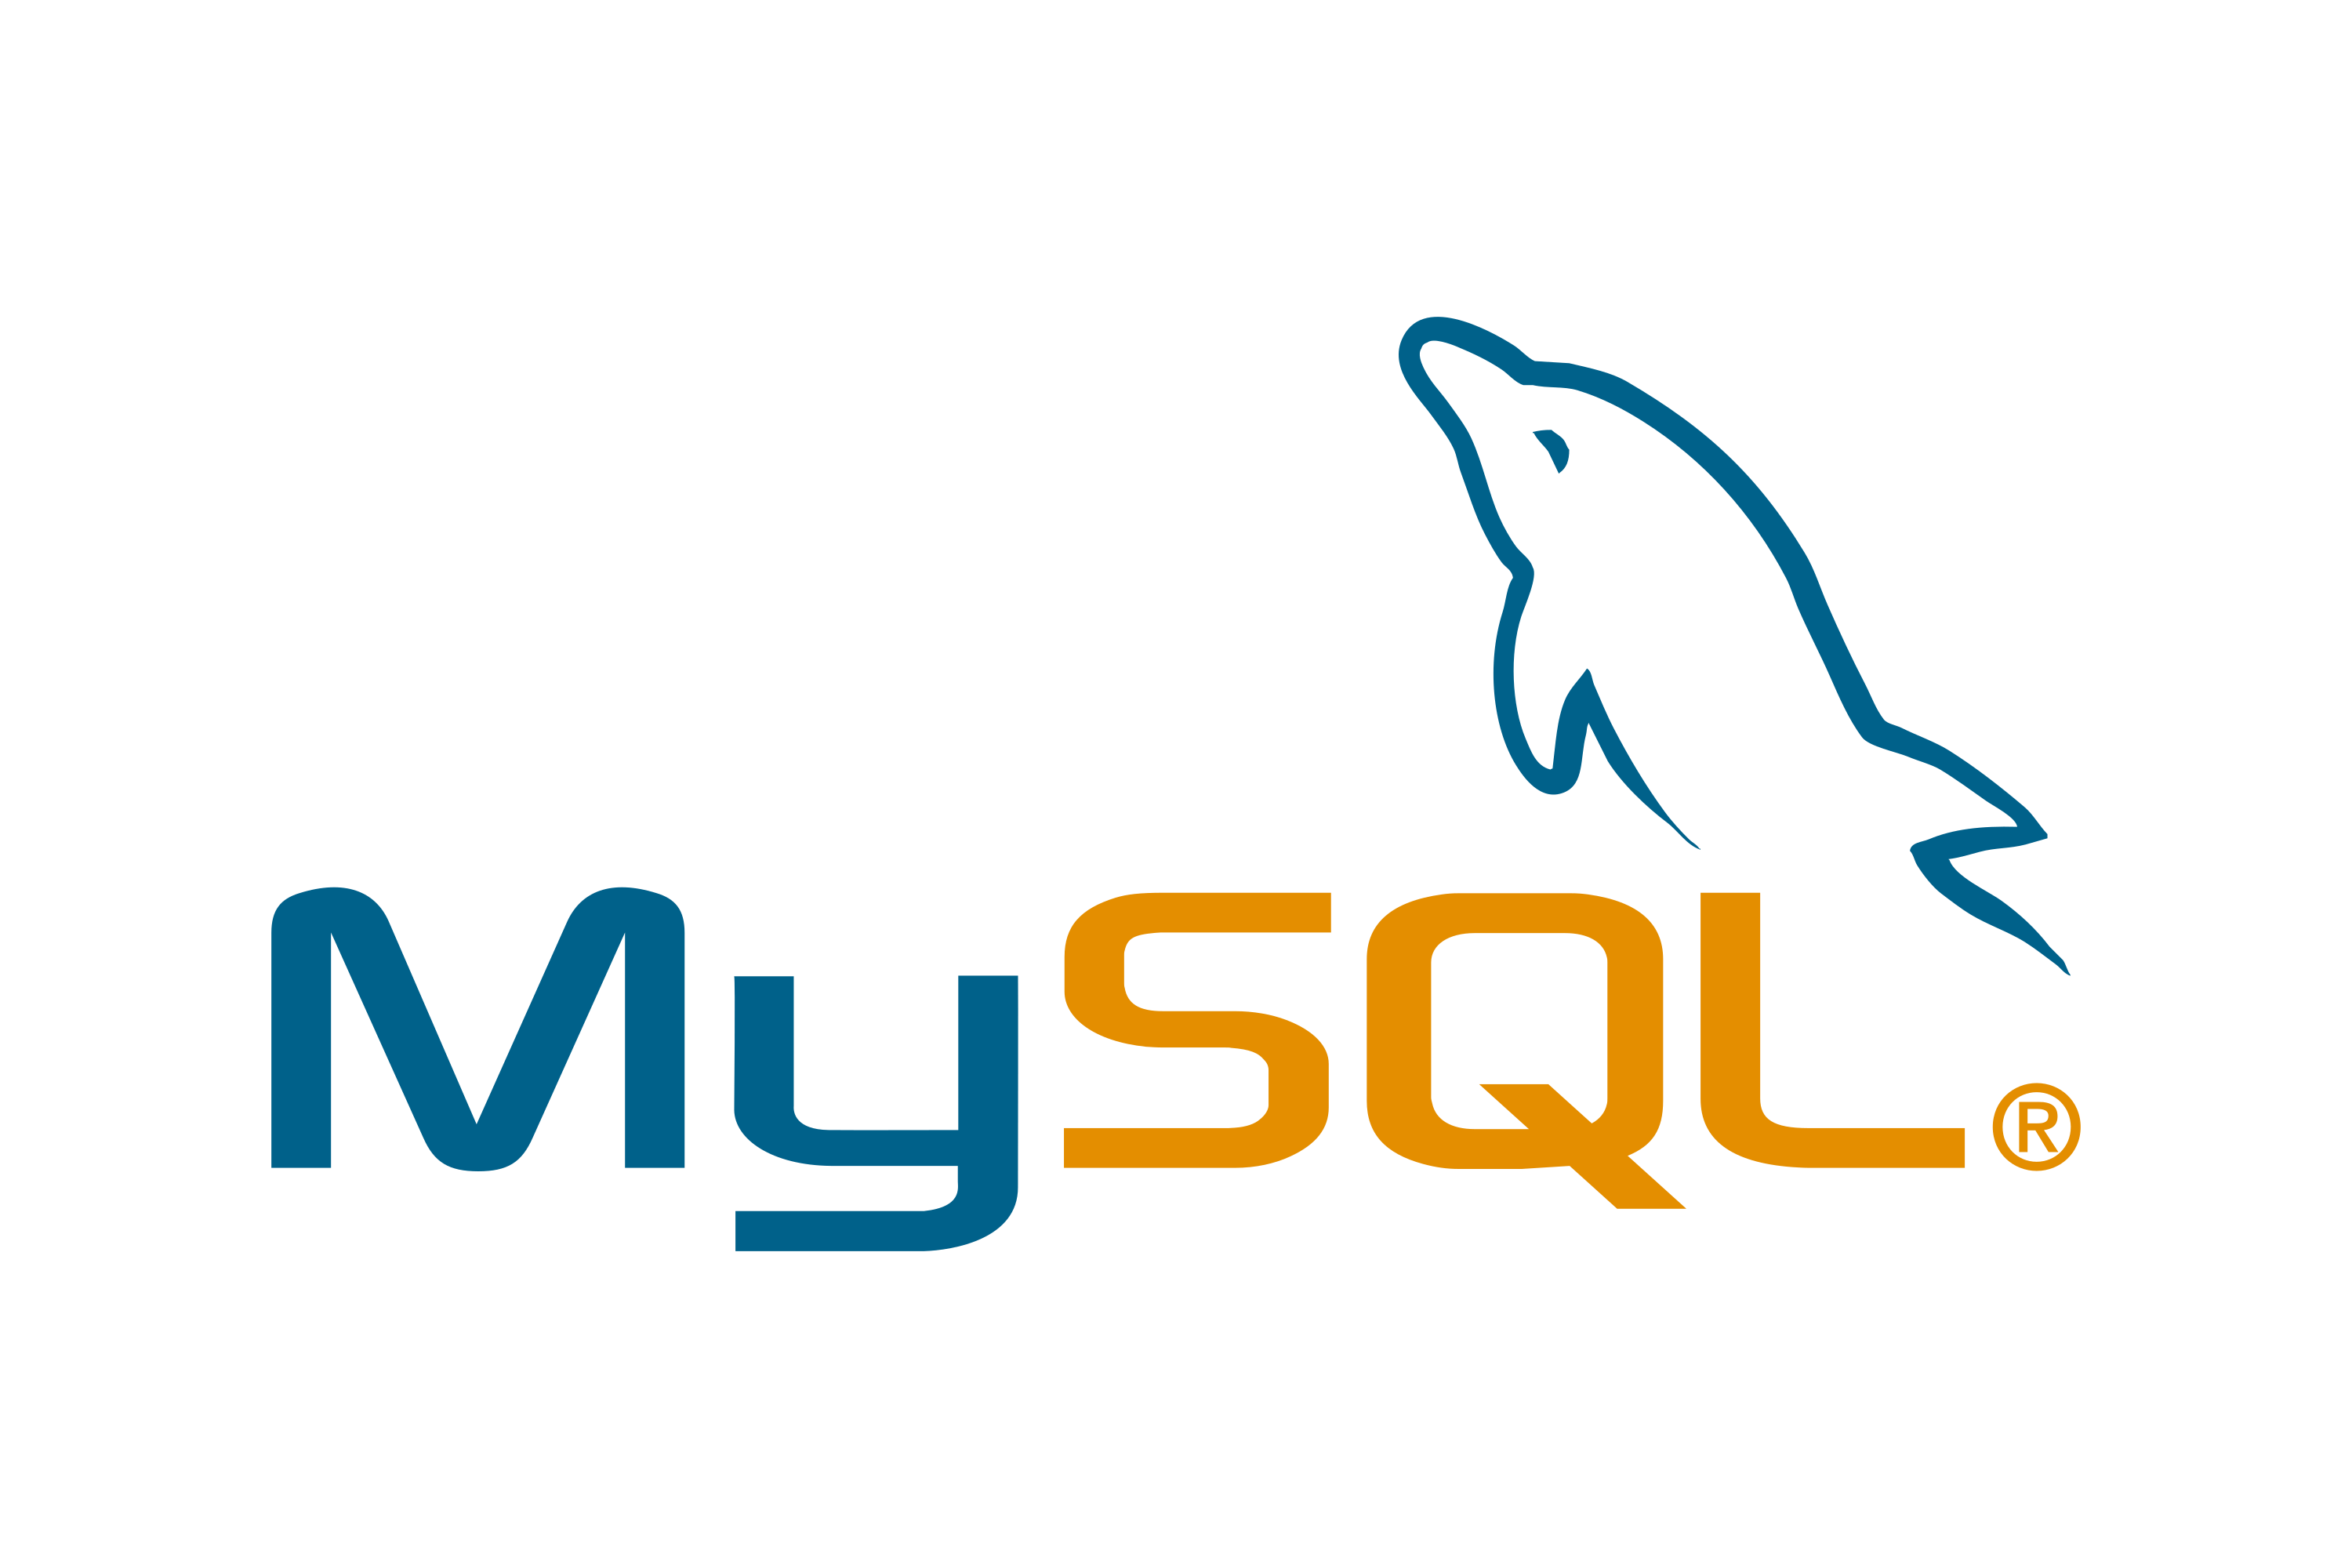
MySQL MySQL is a relational database management system (RDBMS) based on the SQL (Structured Query Language) queries. It is one of the most popular languages for accessing and managing the records in the table. MySQL is open-source and free software under the GNU license. Oracle Company supports it.

Slide 4
The following are the most important features of MySQL:
Easy to use
It is secure
Client/ Server Architecture
Free to download
It is scalable
Fast
High Flexibility
Compatible on many operating systems
Allows roll-back
Memory efficiency
High Performance
High Productivity
Platform Independent
Partitioning
GUI Support
Dual Password Support

Slide 5
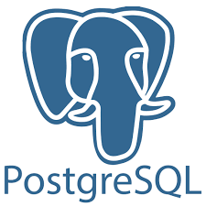
PostgreSQL PostgreSQL is an enterprise-class open source database management system. It supports both SQL and JSON for relational and non-relational queries for extensibility and SQL compliance. PostgreSQL supports advanced data types and performance optimization features, which are only available in expensive commercial databases, like Oracle and SQL Server. It is also known as Postgres.

Slide 6
The Advantages of PostgreSQL :
dynamic websites and web apps
highly fault-tolerant database
source code is freely available under an open source license
supports geographic objects
easy to use
Low maintenance and administration for both embedded and enterprise use of PostgreSQL

Slide 7
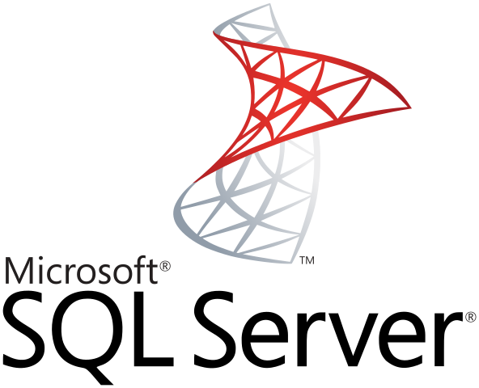
SQL SERVER Microsoft developed and marketed the SQL Server relational database management system (RDBMS) to primarily compete with the MySQL and Oracle databases. It is also called MS SQL Server, which is an ORDBMS, platform-dependent, and can work on GUI and command-based software. The key interface tool for SQL Server is SQL Server Management Studio (SSMS), which operates in both 32-bit and 64-bit environments.

Slide 8
The following are the key usage of MS SQL Server:
Its main purpose is to build and maintain databases.
It is used to analyze the data using SQL Server Analysis Services (SSAS).
It is used to generate reports using SQL Server Reporting Services (SSRS).
It is used to perform ETL operations using SQL Server Integration Services (SSIS).

Slide 9
Comparison of MySQL vs. PostgreSQL vs. SQL Server
In general, both MySQL and PostgreSQL databases fully support ACID and can handle large amounts of data and high levels of query concurrency.
PostgreSQL is more feature-rich and extensible and maybe a better choice for extreme cases.
MySQL is much more popular, suits web applications and e-commerce projects, there are much more blogposts/support/documentation then for PostgreSQL.
For environments with high number of connections - PostgreSQL might need a lot of memory, because each connection has its own memory. However, there are solutions to overcome this issue, like PgBouncers, external connection pools.
Manual partition management in PostgreSQL requires too much overhead and updates that move rows from one partition to another will fail.
There is 1 CPU per query limitation in MySQL and only the nested-loop join algorithm which make MySQL a less optimal choice for data warehouse systems.
If check constraint functionality is important - there are none in MySQL.

Slide 10
General information for MySQL, PostgreSQL and SQL Server
 | MySQL | PostgreSQL | SQL Server
Maturity | Initial release was in 1995 | Initial release was in 1989 | MSMS SQL Server for OS/2 was released in 1989 SQL Server 6.0 was released in 1995
Language | Written in C, has a few C++ modules | Written in C | Mostly C++ with a few exceptions
Cost | Open source / Owned by Oracle and has several paid editions | Completely free / Open source | SQL Server Express is a free edition, but it is limited to using 1 processor, 1 GB memory and 10 GB database files.

Slide 11
Data changes for MySQL, PostgreSQL and SQL Server
 | MySQL | PostgreSQL | SQL Server
Row Updates | Updates happen in place, changed data is copied to the rollback segment. This makes vacuuming and index compaction very efficient. MySQL is slower for reads, but writes are atomic and if columns in a secondary index change, this does not require changes to all indexes | Updates are being implemented as inserts + mark as delete for vacuum. All indexes have a link to the physical id of the row. This has an update amplifying effect because when the column gets updated, new row with new physical id gets created and all indexes require updates, even those which are not referring to the changed column to get a pointer to the new row physical id. | Row-Store database engine: In-Memory database engine: updates implemented as insert + mark for delete. Garbage collector is not non-blocking and parallel Columnstore database engine: in-place updates
Vacuum / Defragmentation | Vacuuming and index compaction are very efficient. | Vacuum performs full tables scans to find the deleted rows and quite heavy process/might impact users’ workload. | In-memory garbage collector might add max ~15% overhead, usually much less

